Slide 1


School of Information Communication and Technology
IT4023E - Data Visualization
PROJECT REPORT
IMDB MOVIE ANALYSIS DASHBOARD
GROUP 10
Name
Student ID
Nguyễn Võ Ngọc Khuê
Nguyễn Hoàng Quân
Nguyễn Hải Đăng
Phan Minh Hòa
Nguyễn Tiến Đạt
20225504
20225519
20225478
20225495
20225481

Slide 2
1. INTRODUCTION

Slide 3


1. INTRODUCTION
Scenario
The film industry has produced thousands of movies over the past century.
With such a large volume of data, it becomes increasingly important to analyze trends and patterns across different dimensions such as genre, release year, rating, and audience response.
Understanding movie performance over time can help filmmakers, analysts, and audiences make better decisions or discover valuable insights.

Slide 4
1. INTRODUCTION
Objective
Provide a clear and interactive overview of movie data from a wide range of sources.
Explore key metrics such as:
Total gross revenue over time
Average ratings and audience votes by decade
Performance by genre and certification
Distribution of movie durations and ratings
Highlight the best and worst performing films
Enable users to filter and analyze the data, allowing for a personalized and flexible exploration experience.

Slide 5
1. INTRODUCTION
Dataset
IMDb Movies Dataset (1915–2020)
This dataset comprises 7,000 movies from IMDb, spanning over a century (1915–2020). It contains the following key attributes for each movie:
Title: Name of the movie
Release Year: Year the movie was released
Genre: One or multiple genres assigned to the movie (e.g., Drama, Comedy)
Certification: Audience suitability rating (e.g., PG, R)
Duration: Runtime of the movie (in minutes)
IMDb Rating: Average rating based on user reviews
Number of Votes: Total votes received on IMDb
Gross Revenue: Box office earnings (usually in USD)

Slide 6
2. THE DASHBOARD

Slide 7
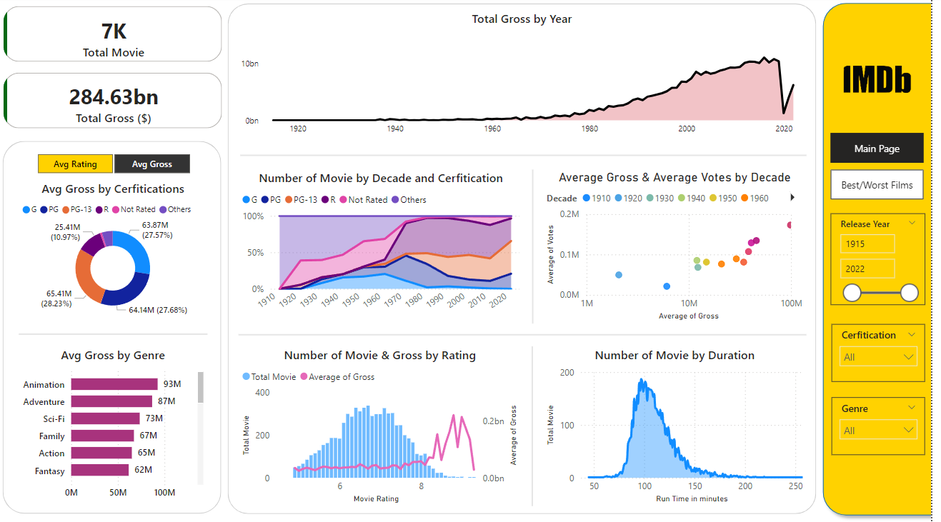
2. THE DASHBOARD
Main Page

Slide 8
2. THE DASHBOARD
KPI Cards
These two KPI cards provide a high-level summary of the movie dataset:
Total Movies: Represents the number of movies in the dataset (7,000 titles).
Total Gross Revenue: Summarizes the cumulative box office earnings, giving an economic context to the dataset.
Together, these cards establish the foundation of the dashboard by offering users an immediate understanding of both the data volume and the financial scale before exploring more detailed insights and visualizations.

Slide 9
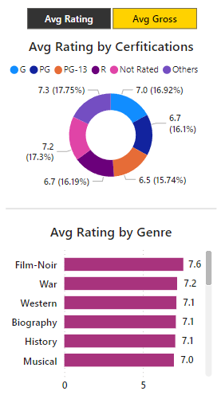
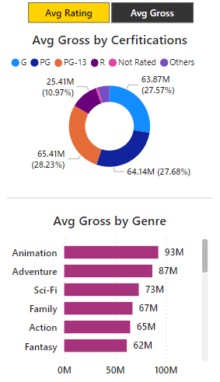
2. THE DASHBOARD
Interactive Rating vs Gross Component
This component offers an interactive toggle between two key metrics: Average IMDb Rating and Average Gross Revenue.
Users can switch views using the toggle buttons at the top of the component.
A donut chart visualizes the selected metric (Rating or Gross) segmented by Movie Certification (e.g., PG, R).
A bar chart displays the selected metric broken down by Genre.
This design empowers users to compare audience appreciation (via average ratings) with financial performance (via average gross revenue) across both certification and genre categories.

Slide 10
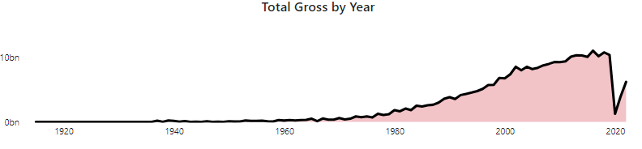
2. THE DASHBOARD
Box Office Revenue Over Time
This area chart visualizes the total box office revenue of movies released from 1915 to 2022:
Highlights the long-term growth of the film industry, with a notable surge starting in the 1980s.
Clearly illustrates the impact of external events, such as the sharp decline in 2020, likely caused by the COVID-19 pandemic.
Provides valuable insights into industry trends, market expansion, and peak revenue periods over time.
This is a powerful tool for understanding how the film industry's financial landscape has evolved across decades.

Slide 11
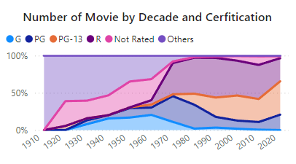
2. THE DASHBOARD
Movie Certification Trends Over Time
This stacked area chart displays the distribution of movies by certification across each decade from 1910 to 2020:
Effectively illustrates how the popularity and usage of different movie certifications (e.g., G, PG, PG-13, R) have shifted over time.
Highlights key trends in content regulation, audience targeting, and industry preferences throughout different eras.
This visualization offers a compelling look at the evolution of film ratings and their influence on production and distribution patterns over more than a century.

Slide 12
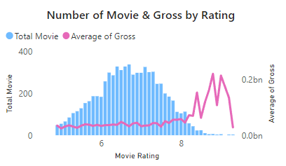
2. THE DASHBOARD
Movie Count vs. Gross by IMDb Rating
This combined bar and line chart visualizes the relationship between IMDb ratings and two key metrics:
Blue bars represent the number of movies for each rating value.
The pink line shows the average gross revenue associated with each rating.
This dual-axis design allows users to analyze how movie frequency and financial performance vary across different IMDb rating scores, revealing patterns such as:
Whether higher-rated movies tend to generate more revenue.
The most common rating ranges in the dataset.
It provides a clear view of how audience perception (ratings) aligns with box office success.

Slide 13
2. THE DASHBOARD
Movie Duration Distribution
This chart illustrates the distribution of movies by duration (in minutes), showing how many titles fall within different duration ranges.
Utilizes a filled line plot to highlight the spread and concentration of movie lengths.
The shaded area under the curve enhances visual clarity, making it easy to identify peak ranges and compare frequencies across lengths.
This visualization effectively reveals common duration trends - such as the typical length of most films - and helps identify outliers or shifts in production norms over time.

Slide 14
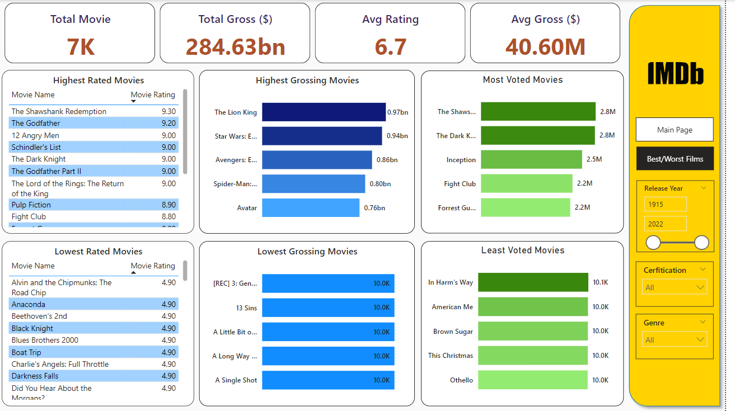
2. THE DASHBOARD
Filter Panel
The right panel of the dashboard enhances user experience and data exploration through intuitive navigation controls and interactive filters.
Page Navigation:
Main Page: Returns to the primary dashboard view, providing overall insights and key metrics.
Best/Worst Films: Switches to a detailed view showcasing the highest and lowest rated, grossing, and voted movies.
Filters:
Release Year: Use the slider or numeric input fields to filter movies by their release years (from 1915 to 2022).
Certification: A dropdown menu lets users filter movies based on audience rating categories (e.g., G, PG, PG-13, R).
Genre: Another dropdown filter allows users to narrow results by genre, such as Action, Comedy, Drama, and more.

Slide 15
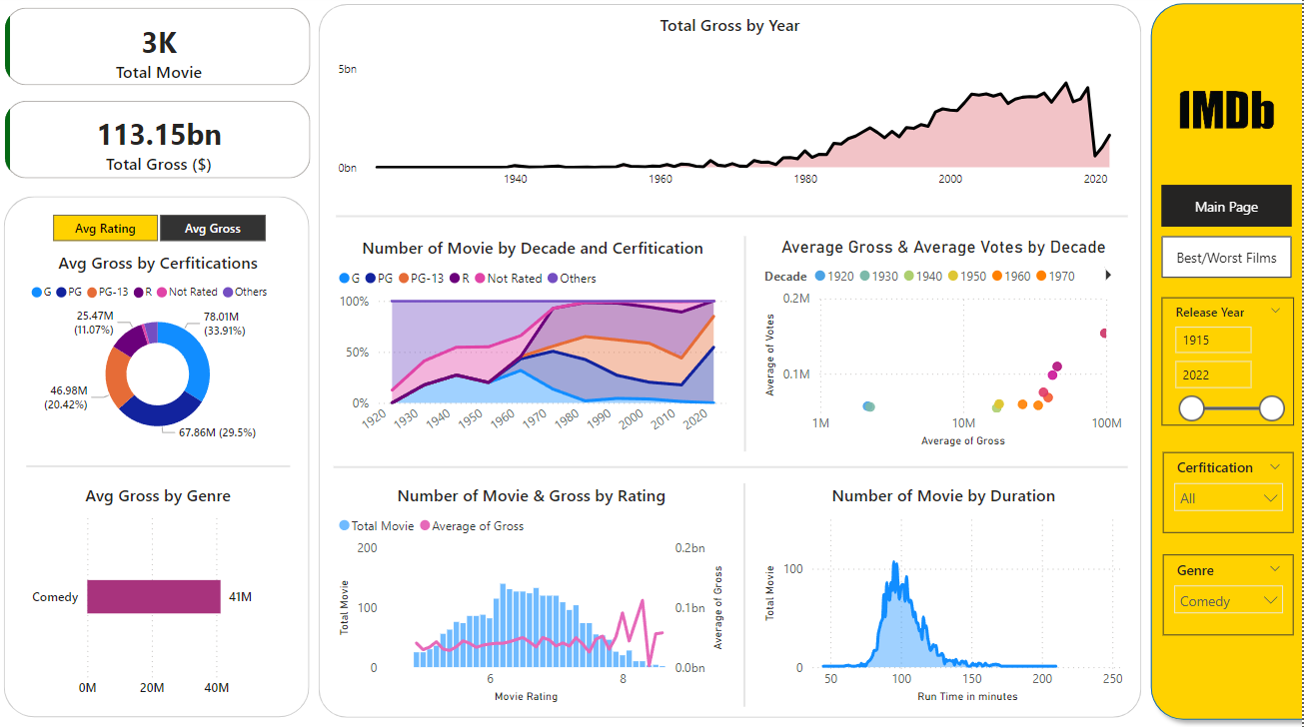

2. THE DASHBOARD
Filter Panel - Interaction
When the genre filter is set to "Comedy", the entire dashboard dynamically updates to reflect data specific to Comedy movies only.
All metrics and graphs across the page become focused on Comedy films, allowing for more targeted analysis of trends, performance, and characteristics within this specific genre.

Slide 16
2. THE DASHBOARD
Best/Worst Films

Slide 17
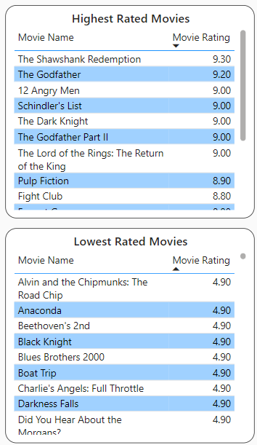
2. THE DASHBOARD
Movie Ratings Table
A table format is used to present movie names alongside their precise numerical ratings, enabling users to:
Easily compare individual values across films
Quickly scan for top- or low-rated entries
View data in a structured, readable format
To enhance usability and interaction:
Selected or active rows are marked with a simple blue highlight, a familiar visual cue that improves readability and helps users track their selections in larger datasets.

Slide 18
2. THE DASHBOARD
Top Movies by Gross & Votes
Horizontal bar charts are used for the "Movie by Gross" and "Movie by Vote" sections. This format is ideal for:
Comparing magnitudes across movie titles
Ensuring longer titles fit cleanly along the y-axis
Making value differences easily interpretable through bar length
To enhance visual impact and readability:
A gradient color scheme is applied, where darker shades indicate higher values and lighter shades represent lower values.
This gradient helps users quickly grasp rankings and value intensity at a glance.

Slide 19
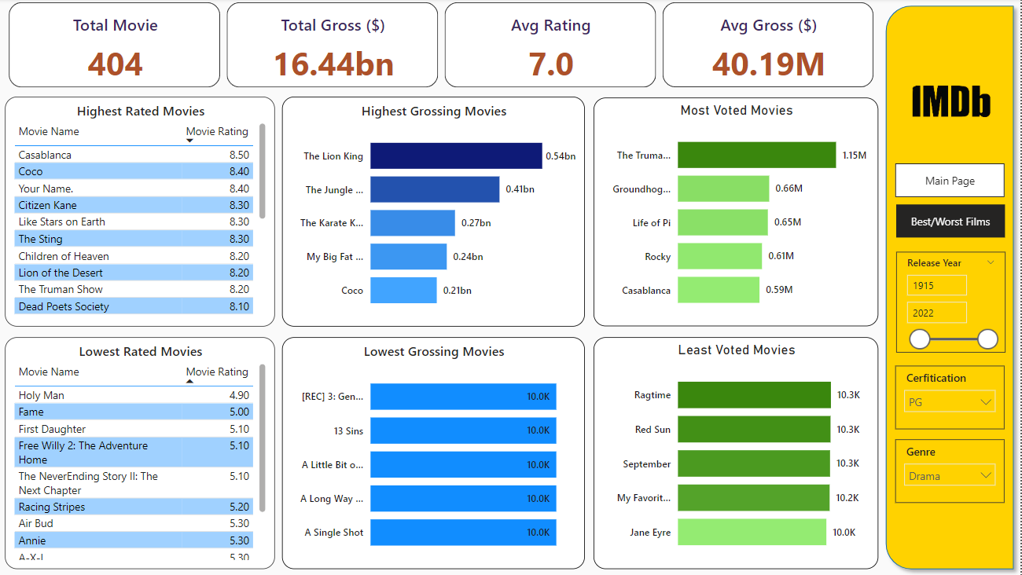
2. THE DASHBOARD
Filter Panel - Interaction
When the Certification filter is set to PG and the Genre filter is set to Drama, the dashboard dynamically updates to show data that only pertains to PG-rated Drama movies
This filter combination enables users to focus their analysis on a more specific subset of films, offering clearer comparisons and deeper insights within the chosen criteria.

Slide 20
3. CONCLUSION

Slide 21
3. CONCLUSION
Key Notes
This dashboard provides a clear and interactive overview of key movie data from 1915 to 2022, covering:
Total movies, gross revenue, and average ratings
Trends in box office performance and rating-to-revenue relationships
Distribution of genres and certifications over time
Insights into lengths, rating scores, and voting patterns
Top and bottom performers in rating, revenue, and votes
With intuitive filters for year, certification, and genre, users can easily explore data based on their interests.
Overall, the dashboard presents movie insights in a clear, organized, and visually engaging way.

Slide 22
THANK YOU!

